Slide 1
Course - DT228/1
Information Technology Fundamentals
INFORMATION TECHNOLOGY DOMAINS
Business, Science, Education

Slide 2
Information in Organisations
Most business organisations exist to make a profit.
They attempt to attain profit by providing products and/or services to customers.

Slide 3
Organisational Structure
The organisation is usually best to adopt a structure, usually hierarchical. In this structure are levels such as;
senior management,
general or middle management,
knowledge workers,
operational workers.

Slide 4
Organisational Structure (2)
In the hierarchy each level will find that there are occupational requirements for information.
For example, the strategic level of senior management will have strategic problems to tackle and will require or create strategic information.

Slide 5
Information System Examples
Examples of;
Strategic information systems for senior management:
Executive information systems,
Decision support systems.
Tactical information systems for middle management:
Project management tools,
Forecasting (database).

Slide 6
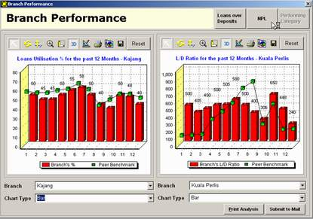
Information System Examples (2)
An Executive Information System

Slide 7
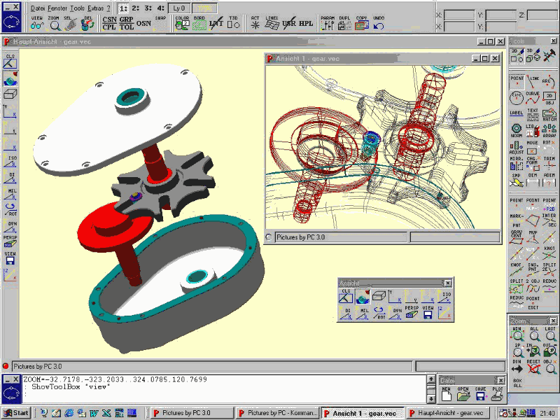
Information System Examples (3)
Knowledge information systems for knowledge workers:
Computer aided design (CAD),
Computer aided manufacturing (CAM),
Administrative systems.

Slide 8
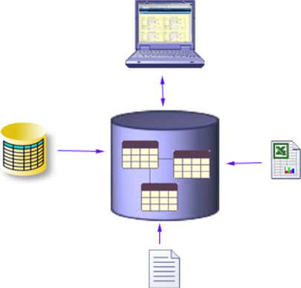
Information System Examples (4)
Operational systems for production workers:
Applications (Word, Excel…)
Robotics
Input-output systems

Slide 9
Structuring Organisations
It is necessary to structure an organisation - no matter what its size.
Most successful organisations apply a top-down approach to structuring work, and so departments within organisations are set up.
With a top-down structure for an organisation it is usually easy to fit a top-down structured information system on this design.

Slide 10
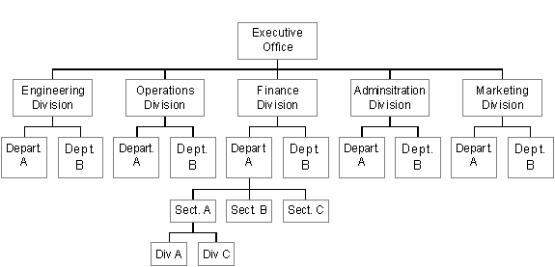
Structuring Organisations (2)

Slide 11
The Role of Information in Organisations
Complete and accurate information is very important to organisations.
Systems analysis attempts to draw out the most important and formal information - to highlight the areas of an organisation that would most benefit from an information system.

Slide 12
The Role of Information in Organisations (2)
The role of information is to allow organisational professionals to make judgements and decisions which are vital to the efficient running of the organisation.
Applying computer technology to organisations is an attempt to control information parameters.

Slide 13
The Role of Information in Organisations (3)
Information might be:
processed faster,
shared by different parts of the organisation and
will be up-to-the-minute.
If information is out of date it can be changed quickly and easily.
An example of all of these is a database.

Slide 14
The Role of Information in Organisations (4)
To help an organisation to make decisions about what sort of business to do - for example, to allow a factory to decide what range of products to make, the factory must be able to gather information on what will sell (and so what is worth manufacturing).
For this the factory will need information about the productivity of each of the items.

Slide 15
The Role of Information in Organisations (5)
The organisation must collect information on the production costs and investment needed for the manufacture of each item.
Identifiable factors will each make up the important elements of the decision-making process.

Slide 16
The Role of Information in Organisations (6)
Example factors;
market price,
sales volume,
existing products,
raw materials costs,
sales outlets and
production location

Slide 17
Information for Outside Organisations
Organisations hold a lot of information because of their involvement with other organisations and individuals.
They exchange information with other organisations to operate efficiently or within the law.

Slide 18
Information for Outside Organisations (2)
Business organisations will exchange information with parties outside such as;
customers,
suppliers,
other businesses,
shareholders,
trade unions,
banks,
local government,
central government to name but a few.

Slide 19
Information for Outside Organisations (3)
For such exchanges of information to take place efficiently, an organisation must organise the way it handles its information.
For example, an organisation might choose to set up departments to take responsibility for controlled information-flow in sections of the whole organisation.

Slide 20
Information for Outside Organisations (4)
Top management may make decisions about the organisation and formulate policies based on such information as market trends, the organisation's competitors and similar types of information.
Middle management requires information about future orders, targets to be met and policies that must be implemented.

Slide 21
Information for Outside Organisations (5)
Supervisory management often requires immediate and rapidly-changing information such as order filling and staffing information - schedules and suchlike.
Computers can help manage information for each of these sorts of managers and ‘systems’ can be used to gather, hold and distribute information relevant to each of them.

Slide 22
How Critical are Computer Systems?
Banks, for example, need Information Technology (IT). Without computing retail banking would break down.
Government health and social welfare agencies (departments) need IT. Distributed processing and large databases are needed for such an establishment.
Other government sectors such as the Revenue Commissioners require complex and secure information systems.

Slide 23

Computers in Mathematics
Models and simulators
Abstraction/simplification – a mathematician can approximate values using the principles of abstraction, using a computer to refine the approximation.
Similarly, in simplification, a complex formula can be simplified by an algorithm. As you may know, algorithms can be turned into computer programs.
A financial model

Slide 24
Computers in Mathematics (2)
If the model is simple enough, you can use traditional mathematics (queueing theory, differential equations, linear programming) to get “answers”.
Nice in the sense that you get “exact” answers to the model, but this might involve many simplifying assumptions to make the model analytically tractable – will outcomes be valid?
Many complex systems require complex models for validity—simulation might be needed.

Slide 25
Computers in Mathematics (3)
A mathematician can try wide-ranging ideas in mathematical models.
The mathematician can make her/his mistakes on the computer where they don’t count, rather for real where they do count.
The mathematician must deal with issues of model validity.
Two types of models are:
Physical (iconic)
Logical/Mathematical such as quantitative and logical assumptions, approximations…

Slide 26
Computers in Mathematics (4)
A language and applications
General-purpose languages (FORTRAN)
Tedious, low-level, error-prone, but almost complete flexibility.
Support packages of software
Subroutines for list processing, bookkeeping, time advance.
Widely distributed, widely modified (by mathematicians, via the internet).
Spreadsheets
Usually static models.
Financial scenarios, distribution sampling, SQC (Statistical Quality Control).

Slide 27
What is Computational Chemistry?
Computational chemistry is the use of computers to determine the movement, design, electronic effects and configuration of atoms and molecules (without given experimental data) which will give faster results than calculating by hand.
For example: if you wanted to know how similar two drugs are to determine if they will have the same effect. You could experimentally test these, which will take months or computationally analyse them which takes minutes.

Slide 28
How Does Computational Chemistry Work?
Computational chemistry is often based on the understanding of quantum chemistry. With this science, if you are able to look to see how small atoms are effected by binding together then you can apply these systems to larger systems (molecules). This science uses many types of chemistry including physical, organic, biochemistry and inorganic with program design.

Slide 29
Why is Computational Chemistry Useful?
A chemist will want to use computers to help limit failures in the lab. Computational chemistry is most useful when it is able to assist the experimenter by limiting experiment failures.
What if you were able to know, within minutes, that a pharmaceutical did not work as well as you might have thought? What if that saved your company millions of Euro?

Slide 30
What are the Limitations of Computational Chemistry?
The limitations of computational chemistry:
It only can simulate real conditions if programmed (where the conditions are programmable).
Larger systems are less accurate then smaller systems due to divergence.
The chemistry needs to be experimentally tested for accuracy. (IE triangulation of experimental results)
Computational chemistry does not look at the ‘whole picture’.

Slide 31

Quantum Mechanics
Currently, quantum mechanical programs are used to determine the single point energy, and geometry optimised position, of desired molecules.
These programs often maintain a wide array of models to use.

Slide 32
Molecular Mechanics
For macromolecular systems, such as proteins, even semi-empirical methods would be too computationally expensive, so molecular mechanisms are used to determine energy and movement.
Molecular Mechanics does not involve the electrons, but known bond angles, bond distances, and energies of amino acids that form proteins. These are then applied to understand proteins.
Computer-generated diagrams can be visual and representative of formulae.

Slide 33
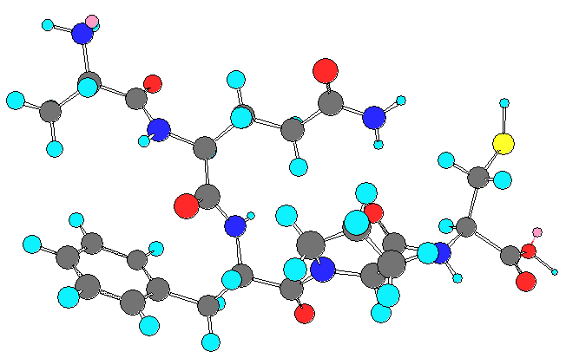
Molecular Mechanics (2)
Cambridgesoft Chem3D Molecular Mechanics (MM2) of Ala-Lys-Phe-Pro-Cys

Slide 34
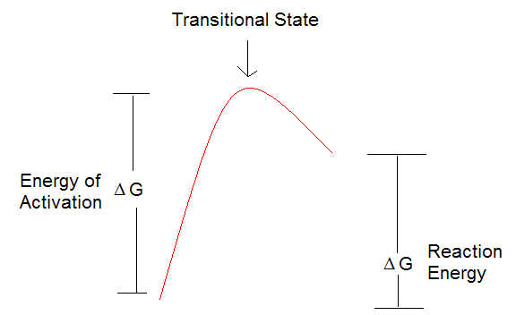
Reaction Mechanisms
Example: energy of activation describes the amount of energy needed to initiate the reaction and allow it to proceed to product formation.
What was down here →
How was it calculated?

Slide 35
Molecular Docking
Molecular docking programs takes two molecules and tries to fit them together. These programs look at both shape and electronics (positive to negative) to determine the best fit.
This can be done between a wide array of molecules from proteins to small molecules.

Slide 36
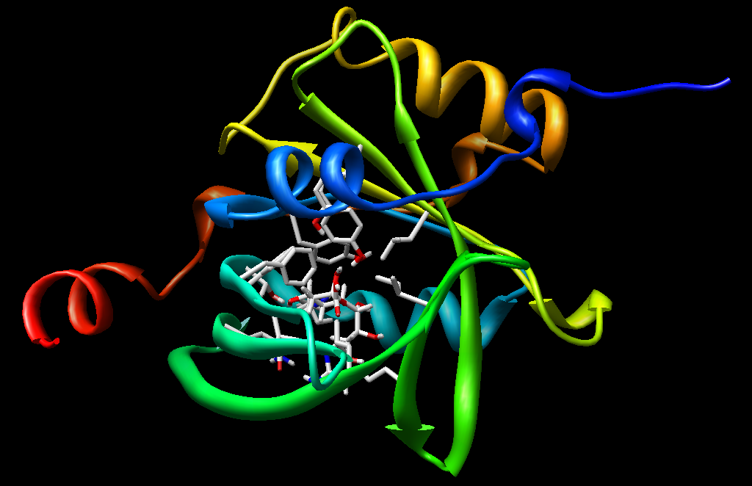
Molecular Docking Diagram
Sialic Acid with α1-AGP Data collected by HEX® visualized by UCSF Chimera

Slide 37
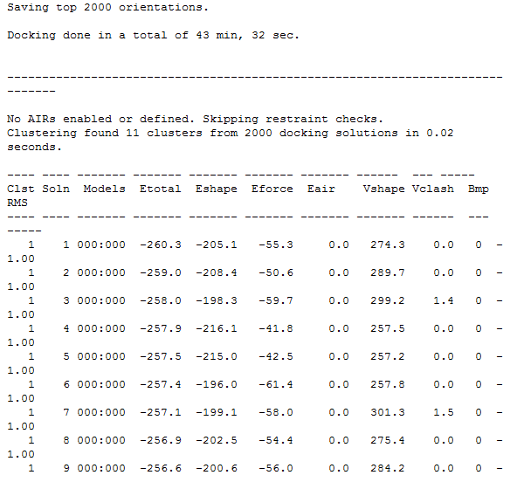
Molecular Docking Data
Sialic Acid with α1-AGP Data collected by HEX®

Slide 38
Molecular Dynamics
Molecular dynamics is the use of computers to understand motions of molecules in different environments.
For example: how does a protein fold? Does it need a chaperone? How much energy does it takes to fold in the proper shape?

Slide 39
Structural Similarity
Structural similarity programs are used to determine how similar molecules are.
For example, what if you have one pharmaceutical that works, but you want to improve its activity? Would you want to synthesize 10,000 derivatives or use a computer program to determine which one would have increased biological activity?

Slide 40
Structural Similarity (2)
Which one will have a similar structure, yet improved biological activity over the known drug?

Slide 41
Atomic/Molecular Visualisation
Currently there are many visualisation programs to visualise molecules and proteins. UCSF Chimera, University of Illinois VMD, VEGA ZZ, and Swiss PDB, to name a few. Each program allows for many file formats to be opened and turned to visually determine the structure.
These programs often show electron density maps and dipoles found in the molecule.

Slide 42
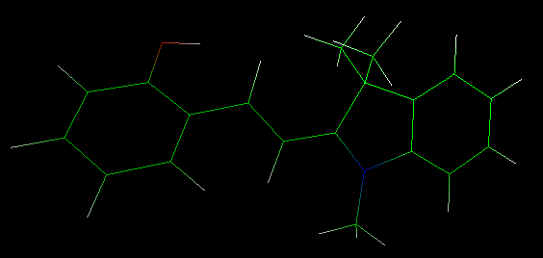
Atomic/Molecular Diagram
Spiropyran visualized with Vega ZZ

Slide 43
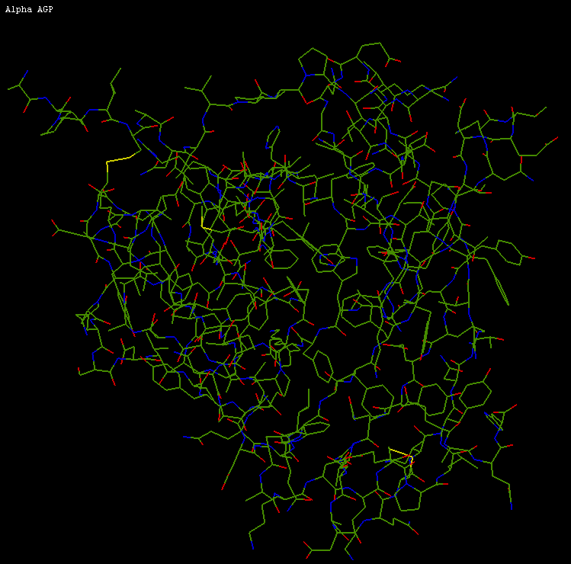
Another Atomic/Molecular Diagram
α1 AGP visualized with HEX®

Slide 44
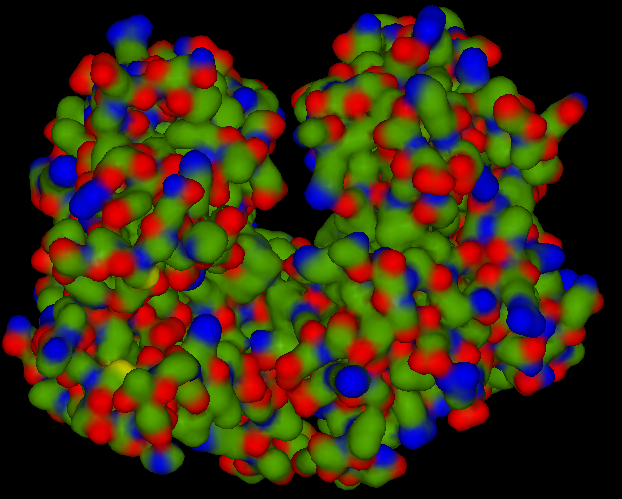
Atomic/Molecular Diagram (3)
TNFα visualized with HEX®

Slide 45
Bioinformatics
Bioinformatics is the use of computers to determine similarities between different proteins.
Programs such as BLAST (Basic Local Alignment Search Tool) are used to determine the similarities between base pairs, for example.

Slide 46
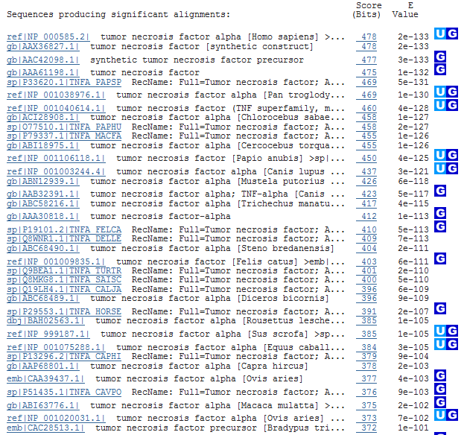
Bioinformatics Data

Slide 47
Computers in Education
Teaching with technology;
Technology is the tool
Teaching about technology;
In the context that technology is constantly changing
Teachers and lecturers who are ‘not techie’ must be comfortable learning new skills.

Slide 48
Computers in Education (2)
Educational Technology
Tools
Multimedia Resources – examples:
Simulation
Games
Drill and Practice
Educational software
Internet

Slide 49
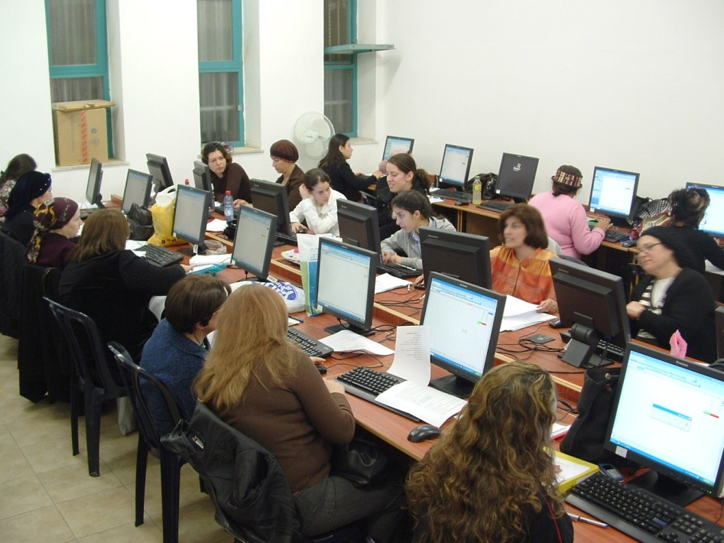
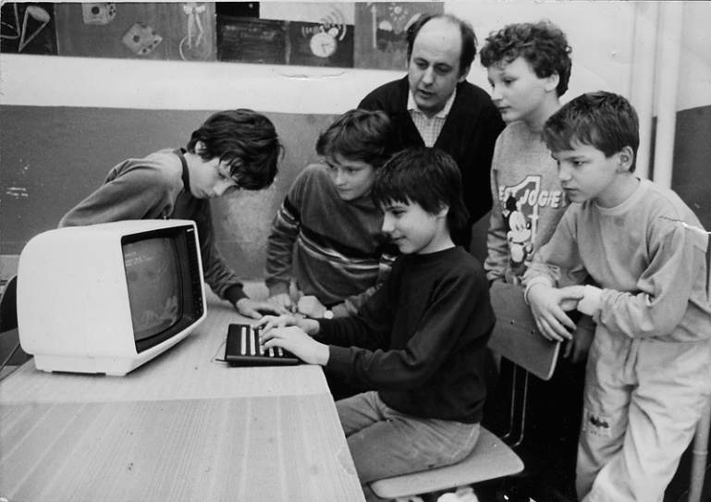
Computers in Education (3)
Without doubt, computers and the internet, as a resource, have enhanced education.
There is much potential for problems, but the benefits outweigh the pitfalls.

Slide 50
What Next?
That’s it for module content – all topics covered!
Next week:
REVISION – including a past paper review

